Slide 1


Slide 2
M&L: Integrating Fedora CoreOs with Hashicorp Nomad
00

Slide 3
M&L: Integrating Fedora CoreOs with Hashicorp Nomad
00
Fedora CoreOs
01
Hashicorp Nomad
02
Integration
03
Notes:
- After very section I will make a naïve and simple demo which is obviously not recommended for production deployment

Slide 4


01. Fedora core os
Container-Optimized: build for container-centric applications.
Automatic Updates: valuable for maintaining the security and stability of your containerized workloads.
Enhanced Security: read-only root file system.
Immutable Infrastructure: eliminate configuration drift and ensures that each deployment is consistent and identical.
Kubernetes Support
Provisioning automation via Ignition
Notes:
Fedora CoreOS is an open-source, minimal, and container-focused operating system (OS) that is designed for running containerized workloads.
It is now part of the Fedora Project, which is sponsored by Red Hat. This also serves as a backbone for the OpenShift cluster
Container-Optimized: very light weight since it has enough dependency just to run container
Immutable Infrastructure: an approach to managing services and software deployments on IT resources wherein components are replaced rather than changed
Provisioning automation : via Ignition file which I’m gonna show you a demo in a few minutes

Slide 5

Container orchestration conversation
devops
me
Other devops

Slide 6

Container orchestration conversation

Slide 7

Container orchestration conversation
Notes:
Docker Swarm does not have full feature from an orchestration

Slide 8

Container orchestration conversation
Notes:
REDHAT openshift is meh…. behind paywall

Slide 9
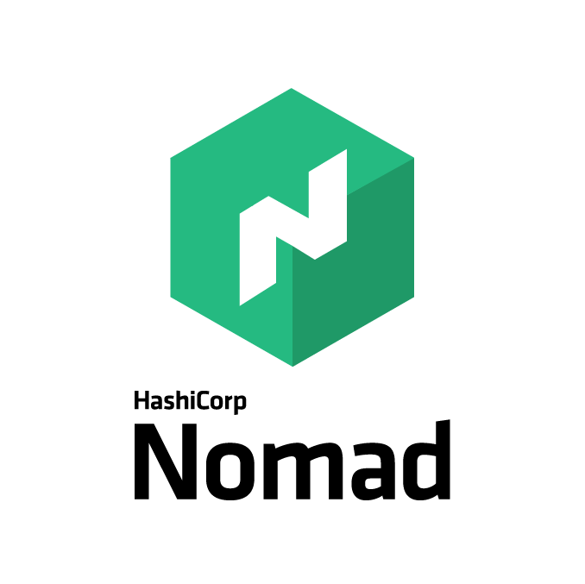
Container orchestration conversation
Notes:
Nomad stand out to be a suitable tool for me.
I already know about HCL (the configuration language from hashicorp which in terraform, vagrant, packer)

Slide 10
02. Hashicorp Nomad
It's quick to install and easy to configure and manage
Doesn't require a big learning curve.
Support multiple workloads
Multi-datacenter and multi-region support
Tight integration with other hashicorp’s tools
Notes:
Doesn't require a big learning curve -> This Simplicity Extends To Its Lightweight Operational Requirements.

Slide 11

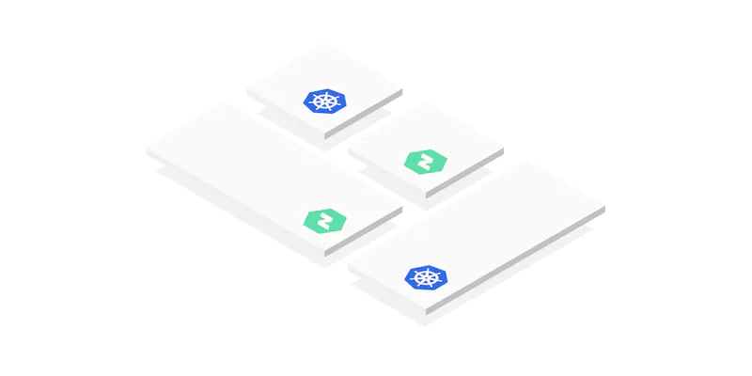
02. Hashicorp Nomad
Kubernetes alternative
Kubernetes Supplement

Slide 12
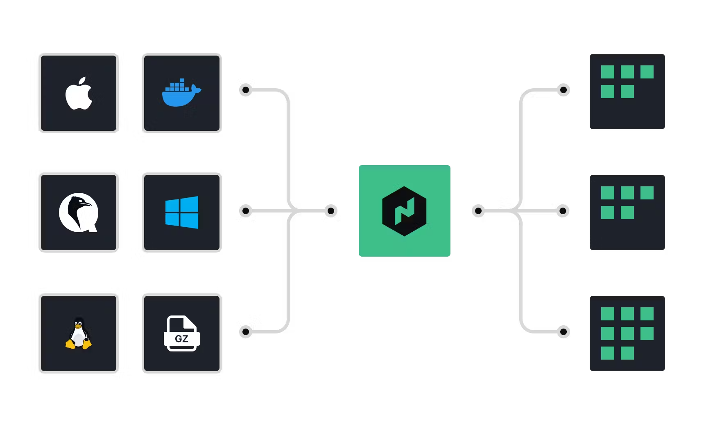
02. Hashicorp Nomad

Slide 13
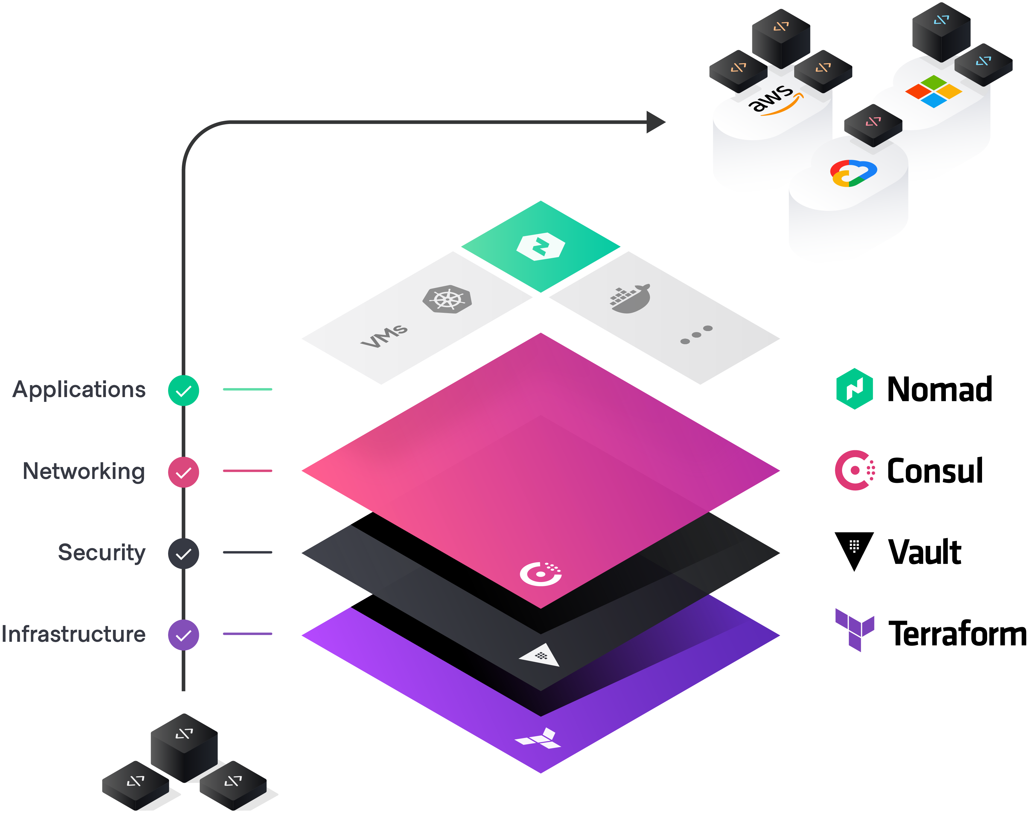
Hashicorp’s tools integrations with Nomad
Notes:
Nomad stand alone itself has build-in some handy feature like services discovery and basic secret manager
But if you want to use something more advance then you need to introduce other in the Hashicorp stack
Such as Consul for services mesh
Vault for dynamic secret or create TLS certificate to communicate between nomad nodes

Slide 14
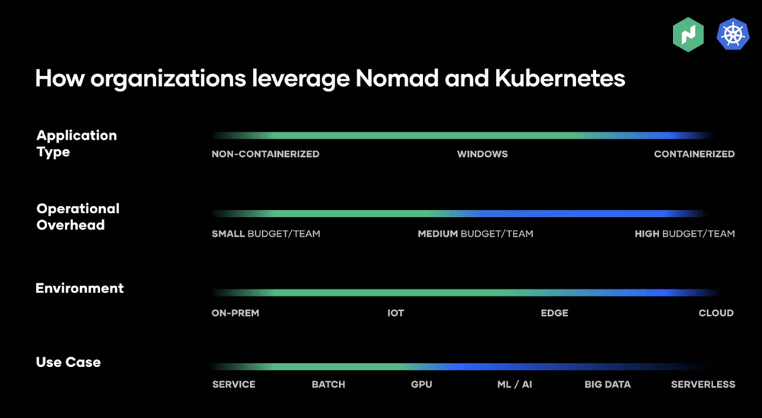
02. Hashicorp Nomad
Consistent Deployment
Nomad as a single binary can be deployed every where in a consistent manner and provides the same operational across environments.
A full Kubernetes installation for a production environment is time consuming, operationally complex, and resource intensive

Slide 15
02. Hashicorp Nomad
Flexible Workload Support
Nomad supports virtualized, containerized and standalone applications, including Docker, Java, IIS on Windows, Qemu, etc.
Kubernetes is specifically focused on Linux containers

Slide 16
02. Hashicorp Nomad
Learning Curve
Nomad is often praised for its simplicity and ease of use, which can result in a less steep learning curve
Kubernetes is known for its steep learning curve due to its complexity and large set of features

Slide 17
03. Intergration
Fedora coreos's update model might cause temporary workload disruptions if not correctly managed.
Can not reuse Cloud-Init configuration.
Incompatible with standard docker-compose file
Nomad lacks some advanced networking capabilities.
Notes:
- Other downside went using Nomad with containerize workload is that we have to covert tradition docker-compose which is support with Kubernetes.
Fedora coreos's update model might cause temporary workload disruptions if not correctly managed.
Incompatible with standard docker-compose file, consume sometimes to translate to nomad jobs configuration.
Nomad lacks some advanced networking capabilities found in other orchestrators. To overcome this, you may need to integrate other tools like consul or third-party networking plugins.

Slide 18
Thank you all !

Slide 19
containerize

Slide 20


0.5. The Fun
Proxmox HA cluster installed in 2 ‘ol laptop.
On this exciting journey, two pieces of technology have truly stood out and found a comfortable place in my home lab's infrastructure - Fedora CoreOS and Hashicorp Nomad.
They may not be the usual suspects you'd find in a standard setup, but their lightweight design, impressive versatility, and surprisingly powerful capabilities have made them a joy to work with.
Notes:
Before going to the detail, I want to talk about the reason behind my decision.
In my quest to continually learn and experiment with new technologies, I've been tinkering with a home lab set up from a few old computers. It may not be a supercomputer cluster, just around 20 vCPUs, but let me tell you, it's a perfect playground for my tech explorations.
On this exciting journey, two pieces of technology have truly stood out and found a comfortable place in my home lab's infrastructure - Fedora CoreOS and HashiCorp Nomad. They may not be the usual suspects you'd find in a standard setup, but their lightweight design, impressive versatility, and surprisingly powerful capabilities have made them a joy to work with. So, come join me as I share my fascinating experiences and insights exploring Fedora CoreOS and Nomad in my humble yet wonderful home lab!

